Slide 1


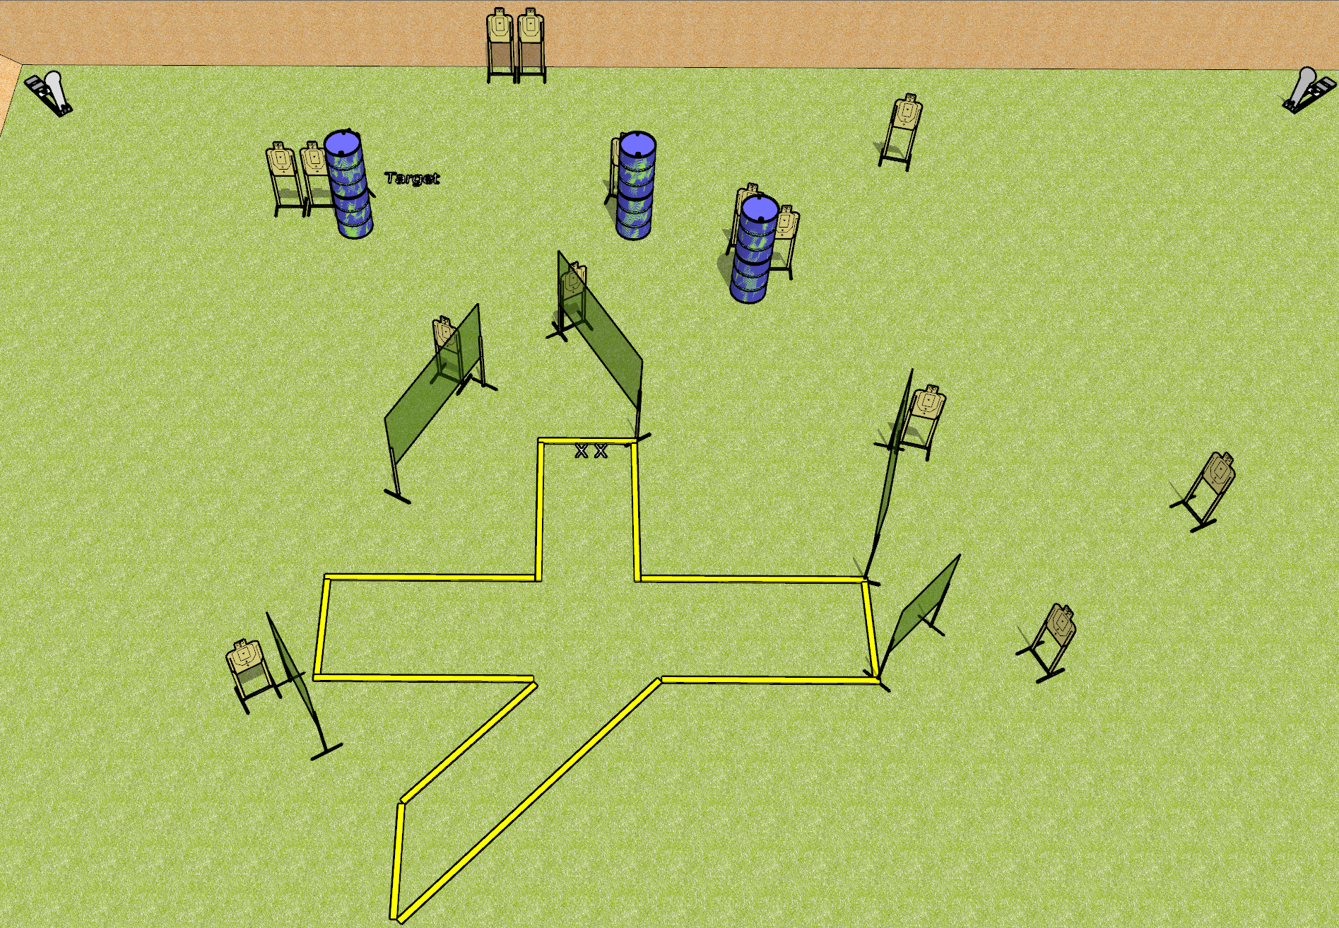
 | Dothan Gun Club – USPSA Match Splat Course Designer : Drew Coleman
Round Count 15 USPSA 2 colt poppers
Equipment List 10 wall feet 4 medium fault lines 15 targets

Slide 2
Splat
Written Stage Briefing
Splat is a 32 round, 160 point, Comstock course of fire. There are 15 USPSA targets and 2 colt poppers. The best 2 hits on paper will score, and steel must fall to score. The start signal is audible.
Handgun start position is toes on X’s, facing downrange, wrists below belt. Handgun is loaded and holstered.
PCC start position is toes on X’s, facing downrange, stock on belt. Loaded carbine is held with both hands, safety on.
On start signal, engage targets as they become available from within the shooting area.

